Slide 1


Chess Game Project
By: Lou Foua, Zack Harris, and Connor King
A Java implementation based on the most popular board game in the world.

Slide 2
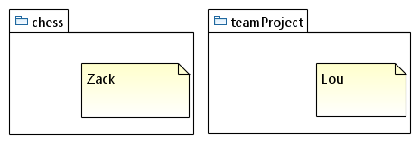
Package Diagram
Updated Package Diagram

Slide 3
Database Design Diagram (ER Diagram)
We tried to implement a database and could not get it working.

Slide 4
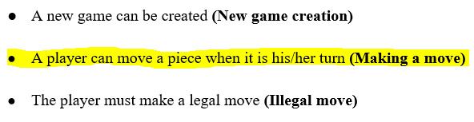
Functional Requirement Example
a. Making a Move - in chess, a move is defined as a player selecting a piece and moving it in the piece’s defined pattern.

Slide 5
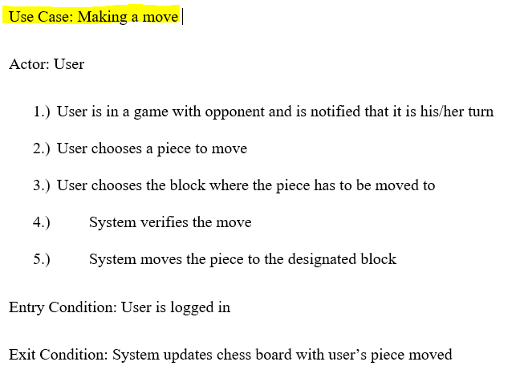
Use Case Description Example
The Actor is the User. There is an entry condition and an exit condition.

Slide 6
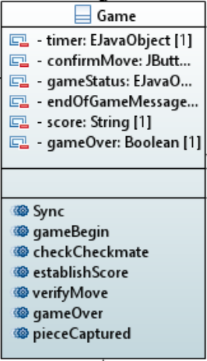
Class Diagram Example
The initial diagram for the Game class consisted of a number of data fields and methods that were found to be inadequate for one class upon implementation. Decided to split this up into multiple classes.

Slide 7
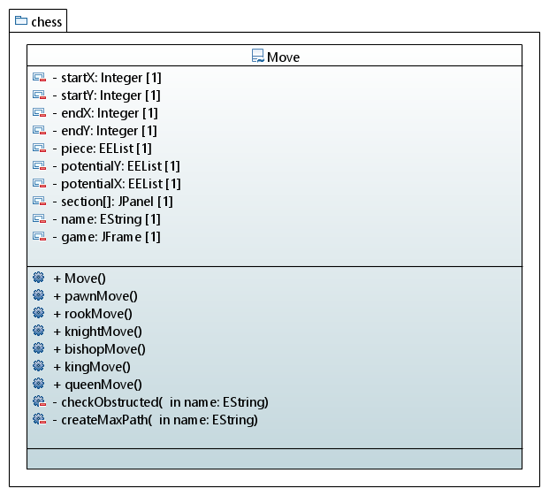
Final Class Diagram
This is the updated version that most resembles the Game class. We have several different attributes and operations.

Slide 8
Time for Demo!

